Slide 1

Computational Analysis of Religious and Ideological Linguistic Behavior
University of Virginia, MS in Data Science Capstone
Samantha Garofalo, Seth Green, Leigh Harton, Megan Stiles
Advisor: Don Brown
Client: Peter Ochs
Sponsor: ARL

Slide 2
Problem: How to work with Value-Based Groups?
What is a Value-Based Group?
Any group motivated by a set of values
Who needs to work with Value-Based groups?
US Government
Humanitarian Groups
Business Leaders
Large-Scale Goals:
Real-time recommendations to organizations on the ground

Slide 3
UVa Center for Religion, Politics, and Conflict
1-9 Linguistic Rigidity Scale
Number of definitions not the definition itself is what matters
Venuti et al. automated model
1 2 3 4 5 6 7 8 9
Holy
Self-Sacrifice
Compassion
Wisdom
Trustworthiness

Slide 4

About Our Data
Input
Raw ideological text
Output
Number on Linguistic Rigidity Scale
Sources:
Last year’s corpus
New Groups
Web Scraping
OCR for PDFs
5

Slide 5
Technical Approach

Slide 6
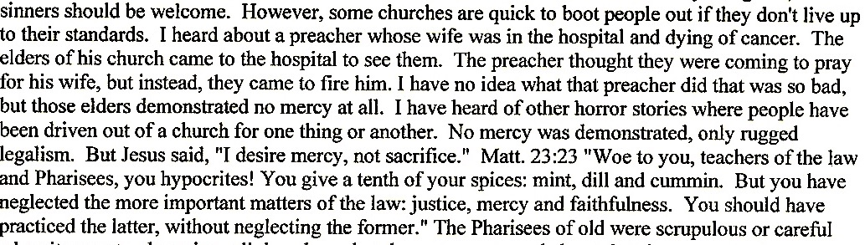
Context Vectors
Raw Text

Slide 7
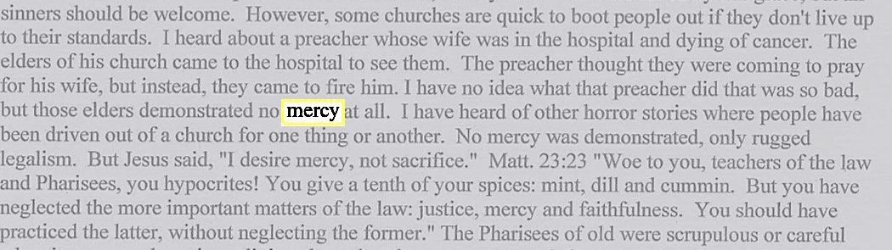
Context Vectors
Identify Keywords

Slide 8
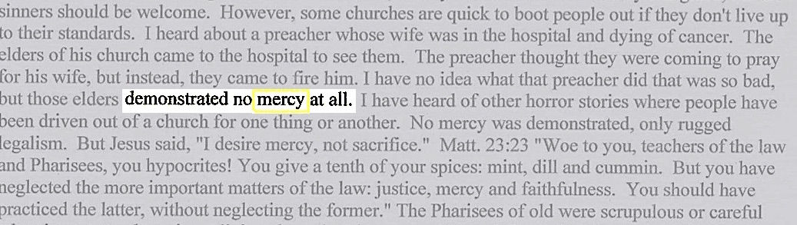
Context Vectors
Collect words in context vector

Slide 9
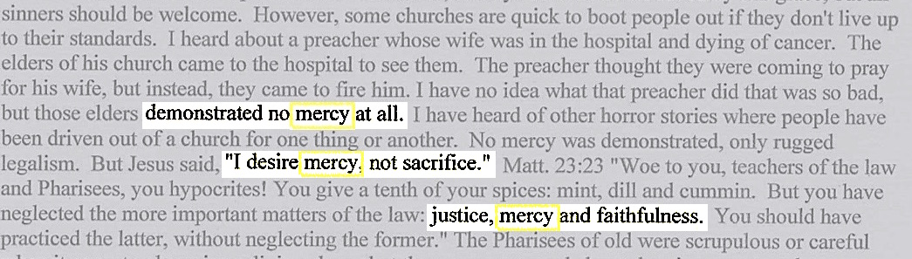
Context Vectors
Repeat for all occurrences of keyword
Singular Value Decomposition to vector of length 100
Calculate Average Semantic Density and Distributional Co-occurrence Score

Slide 10
Keyword Selection

Slide 11
TFIDF Matrix
 | freq | idf | logidf | tfidf | logtfidf
thee | 18 | 139.000000 | 4.934474 | 2502.000000 | 88.820531
prophet | 12 | 139.000000 | 4.934474 | 1668.000000 | 59.213687
me | 12 | 139.000000 | 4.934474 | 1668.000000 | 59.213687
we | 21 | 75.818182 | 4.328338 | 1592.181818 | 90.895101
uniti | 9 | 139.000000 | 4.934474 | 1251.000000 | 44.410265
fate | 8 | 139.000000 | 4.934474 | 1112.000000 | 39.475791
muhammad | 8 | 139.000000 | 4.934474 | 1112.000000 | 39.475791
decre | 8 | 139.000000 | 4.934474 | 1112.000000 | 39.475791
christ | 10 | 104.250000 | 4.646792 | 1042.500000 | 46.467919

Slide 12
Value Words
Previous Method
TFIDF Method w/Pronouns
TFIDF Method w/out Pronouns

Slide 13
Judgment Classification
Previous Method:
Judgment = (noun + “to be” verb + adj/adv)
New Method:
Judgment = pronoun + key word

Slide 14
Judgment Classification

Slide 15
Pronoun Analysis

Slide 16
Results – Group Scores
97%

Slide 17
Results – Group Scores
Compared to Previous Methods using Previous Corpus
Using Full Data Set
Model | Accuracy | Previous Work
Random Forest | 96.5 | 86.0
SVM | 97.2 | 84.0
Boosted Tree | 96.2 | N/A
Artificial Neural Net | N/A | 80.0
Average | 96.6 | 83.3
Model | Accuracy
Random Forest | 96.1
SVM | 96.3
Boosted Tree | 95.4
Average | 96.0

Slide 18
Single Document Analysis
Why Single Documents?
Identifying potential spikes or deviations from a groups baseline
Moving towards real-time, on-the-ground analysis
# of Documents
342
Results
~77% accuracy
3
4
5

Slide 19
Word Embeddings
What are Word Embeddings?
Vocabulary mapped to vectors
When trained on Google News articles, similar words to “book”:
memoir | novels
paperback | hardback
autobiography
When trained on Christian News articles, similar words to “book”:
church | self
son | priesthood
tradition

Slide 20
Questions?

